Slide 1
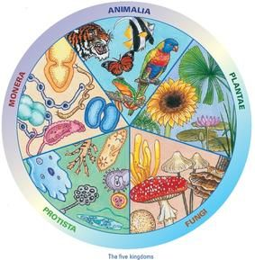
UNIT 8: MICROORGANISMS. THE SIMPLEST KINGDOMS.
What is a microorganism? Tell me 3 examples.
TRADITIONAL CLASSIFICATION
5 KINGDOMS
MONERA
PROTOCTISTA
FUNGI
PLANTS
ANIMALS
1
2
3

Slide 2
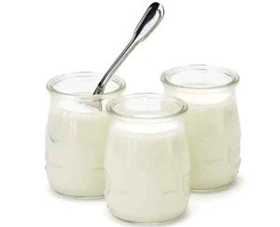
DO NOW:
Why is it good for you to eat yougurts?
Do they have any other beneficial component apart from calcium?
Do you think yougurts contain Bacteria?
What do bacteria give to our body?

Slide 3
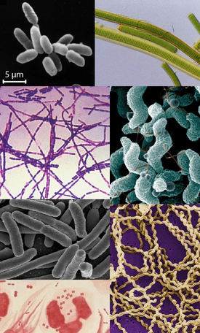
1. KINGDOM MONERA
Kingdom Monera is formed by unicellular prokariotes. The most well-known are bacteria.

Slide 4
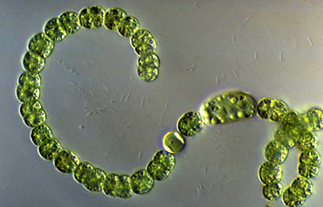
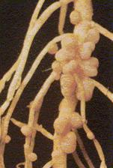
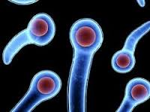
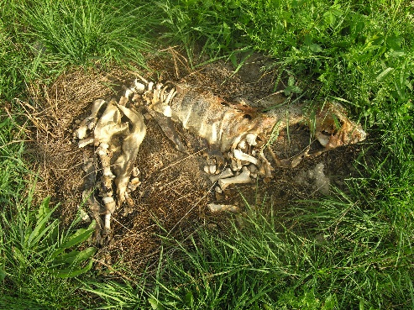
1. KINGDOM MONERA
3 VITAL FUNCTIONS IN BACTERIA
Please remind me the 3 vital functions all living organisms carry out…
NUTRITION
AUTOTROPHIC
(through photosynthesis)
Why are cyanobacteria green?
HETEROTROPHIC
can be
Cyanobacteria
SAPROPHYTIC BACTERIA OR DECOMPOSERS
SYMBIOTIC BACTERIA
PARASITIC BACTERIA
Bacteria helps to take nitrogen and create bubbles in the roots of clovers
Bacteria that produces Tetanus.

Slide 5
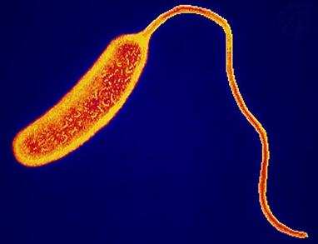
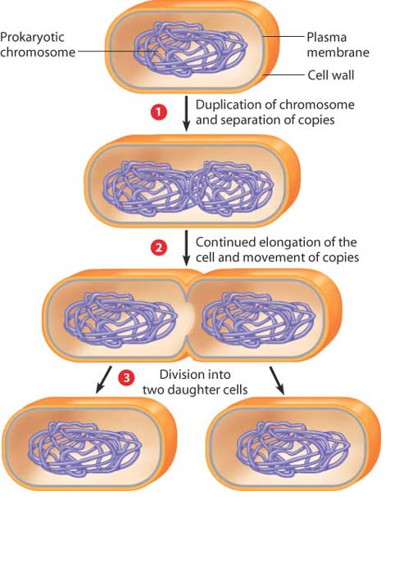
INTERACTION
IMMOBILE BACTERIA
1. KINGDOM MONERA
MOBILE BACTERIA
with flagella
REPRODUCTION
ASEXUAL REPRODUCTION called BIPARTITION
VIDEO
It’s a really quick process!!
Two daughter cells are completly identical to the mother cell.

Slide 6
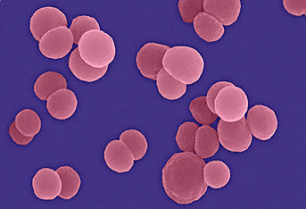
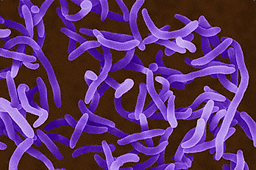
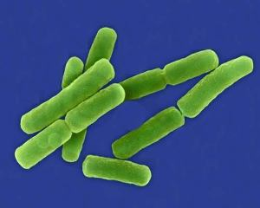
Please draw in the blackboard a bacteria. Now draw another one with a different shape…
1. KINGDOM MONERA
TYPES OF BACTERIA
Depending on shape
COCCI
SPIROCHAETES
VIBRIOS
BACILLI
Spherical shape
Comma or curved shape
Rod-shaped
Spiral shape
WHERE CAN WE FIND BACTERIA?
Remembe r the previous class and part of today to tell me where can we find bacteria?
In the air, water, ground and humans.

Slide 7
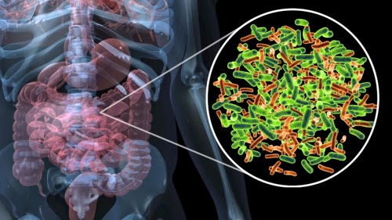
1. KINGDOM MONERA
BACTERIA, PEOPLE AND ENVIRONMENT
HARMFUL BACTERIA
But, do you think all bacteria are parasitic and cause illness?
NO
Cause illness.
Examples: tuberculosis, salmonelosis and tetanus.
Cured with antibiotics.
HELPFUL BACTERIA
Symbiosis with humans (intestine)
Maintain ecosystems (decompose materials)
Bacteria to make cheese and yougurt.

Slide 8
1. KINGDOM MONERA
AND TO END WITH BACTERIA…
BACTERIA ARE ALSO BENEFITIAL

