Slide 1
DO NOW:
Are dogs and cats in the same group?
Are dogs and bears in the same group?
Are dogs and ducks in the same group?
Are dogs and mosquitoes in the same group?

Slide 2
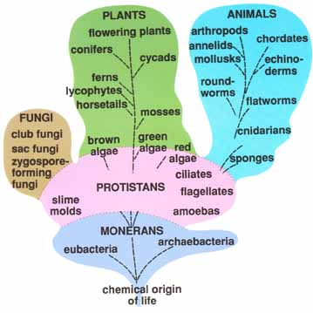
CLASSIFYING LIVING ORGANISMS

Slide 3
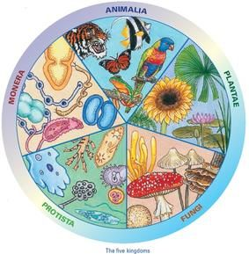
Classification of living organisms.
Why do we need to classify living organisms?
TRADITIONAL CLASSIFICATION
5 KINGDOMS
MONERA
PROTOCTISTA
FUNGI
PLANTS
ANIMALS

Slide 4
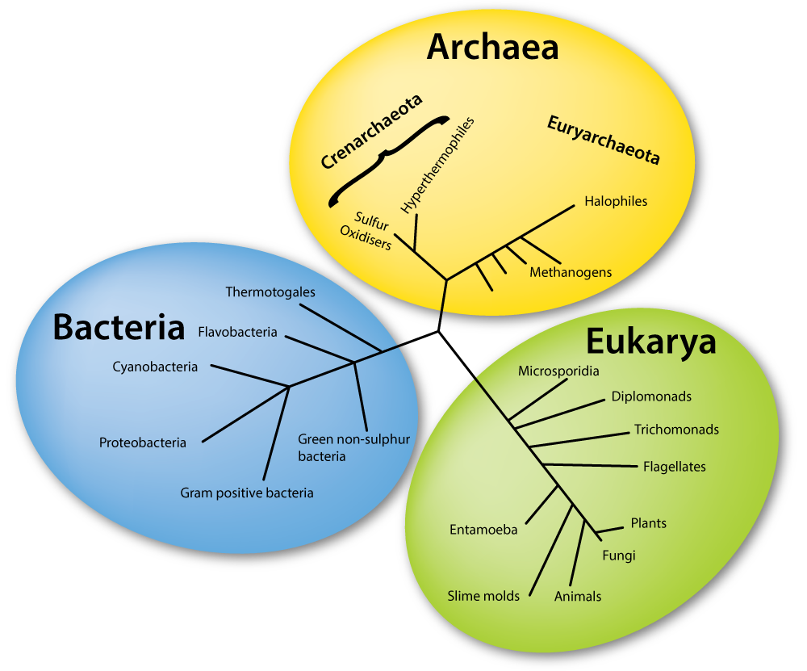
MODERN CLASSIFICATION
3 DOMAINS
BACTERIA
ARCHAEA
EUKARYA

Slide 5
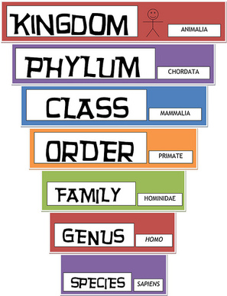
KING
PHILLIP
CAME
OVER
FROM
GREAT
SPAIN
SCIENTIFIC NAMES

Slide 6
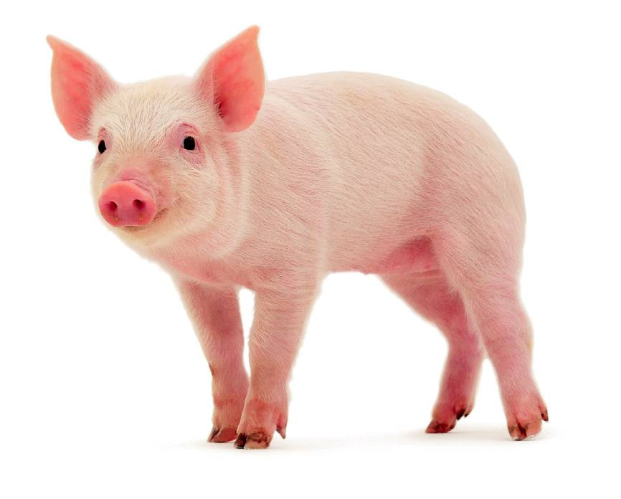
Scientific names
How do we call the animal in the picture? Tell me different names.
Common names change depending on the place.
Scientific names are the same all over the world.
Common name: Pig
Scientific name: Sus scrofa domestica

Slide 7
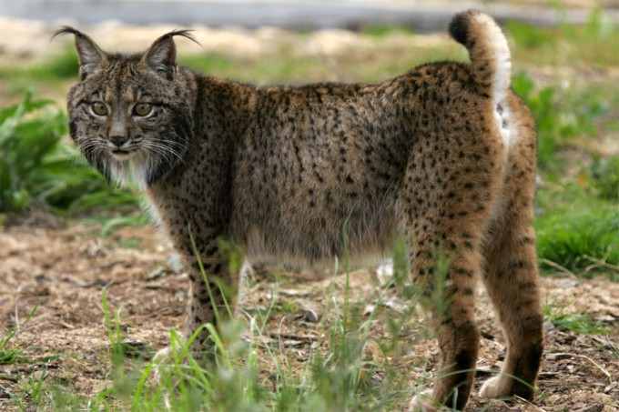
Scientific names
A species is a group of individual with similar characteristics which can interbreed and produce fertile offspring.
FIRST WORD
Genus
SECOND WORD
species
Lynx
pardinus

