Slide 1
The structure of an ecosystem.
What is the biosphere and the ecosphere?

Slide 2
Biosphere - Ecosphere
Biosphere: is the life zone of the Earth. It includes all living things and organic matter.
Biosphere is the living component or the ecosphere.
Ecosphere includes the large-scale ecosystems of the world.
An ECOSYSTEM is a section of the biosphere formed by living organisms, the relationships between them and the physical environment.

Slide 3
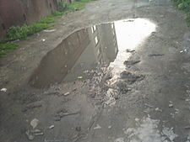
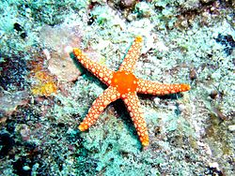
Biomes - ecosystems
Biomes are the large-scale ecosystems of the world.
An ecosystem can be as small as a puddle or as large as an ocean.

Slide 4
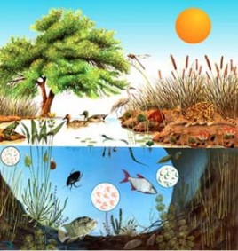
Ecosystem: biocenose + biotope

Slide 5
Components (1)
Ecosystems have two components:
Biocenose: the set of living beings in the ecosystem: animals, plants, fungi, and all types of microorganisms. Biotic factors are the effects which other organism have on a living being in its environment.

Slide 6
Components (2)
2.- Biotope: is the inorganic part of the ecosystem, the physical environment. Abiotic factors are the physical and chemical elements in an ecosystem which affect living organisms. It includes: temperature, humidity, soil, energy, pollution…
Tolerance limits are the values of a particular abiotic factor which must not be exceeded if a species can survive.
Living organisms can resist some variations in those factors, but sometimes a change in a factor can be vital and can be the reason for desappearing. Ex: temperature or humidity. The factor is called LIMITING FACTOR and has less tolerance

Slide 7
Examples of abiotic factors
(Biotope):
Temperature
Light
Humidity
Pressure
Salinity
Oxygen
Water
Soil
Climate zones
Levels of plants in a forest

Slide 8
Biotic relations:
The interactions among the living beings in an environment.
There are two types:
Interspecific
Intraspecific

Slide 9
Interspecific:
Interactions among organisms of different species.
Mutualism. Two organisms for mutual benefit. (Bees and flowers) SYMBIOSIS:can’t live apart!!!
Commensalism: One benefits and the other is not affected. (Beetles and mammal excrements)
Inquilinism: One organism uses the other for housing (crabs and shells)
Parasitism: A parasite lives at the expense of a host and harms it. (Cochineals on plants)
Depredation: A predator kills and eats a prey.

Slide 10
Interactionsamongorganismsof thesamespecies.
1.
Gregarious: Groupsof individualsthatlivetogetherforsometime to providemutual help. (migratingbirds)
2.
Colonial: Relatedindividualslivetogether. Coral
3.
Social: Groupsof individualsorganizedin a hierarchy.(Ants)
4.
Familial: Groupsof relatedindividualswhichlivetogetherto procreateand protecttheYoung.
5.
Competence: forthesamefood, territoryorfemales.6.Colaboration: likein familiesorothergroups.
Intraspecific relations:
Interactions among organisms of the same species.
1.Gregarious: Groups of ndividuals that live together for some time to provide mutual help. (migrating birds)
2.Colonial: Related individuals live together. Coral
3.Social: Groups of individuals organized in a hierarchy. (Ants)
4.Familial: Groups of related individuals which live together to procreate and protect the young.
5.Competence: for the same food, territory or females.
6. Colaboration: like in families or other groups.

Slide 11
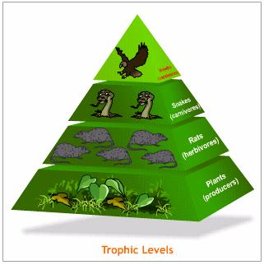
How do living things obtain food?
Living organisms can be classified according to the way they obtain food. It determines their trophic level, that is their place in a food chain.

Slide 12
Producers:
They are the living beings which make their own organic matter from carbon dioxide, water and mineral salts (inorganic matter).They use the energy of the Sun during photosynthesis.
This is autotrophic nutrition.
Plants, algae and some bacteria.

Slide 13
Consumers:
They are living beings that cannot produce their own organic matter. They feed on organic matter produced by other living beings.
This is heterotrophic nutrition.
Primary consumers: Feed on producers: Herbivores.
Secondary consumers: carnivores
Tertiary consumers: feed on primary and secondary consumers and producers.Omnivores
Decomposers: They decompose organic matter into inorganic matter.

Slide 14
Trophic dynamics
Is the system which describes the position of a living being in a food chain. It is the system that explains what an organism eats or is eaten by.
It is represented by a food web. A food web is formed of some food chains interconnected.
Example:
Grass rabbit wolf

Slide 15
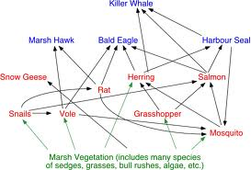
Food web:

Slide 16
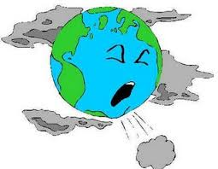
The ecosystems imbalances
​The very rapid population growth produces the destruction of the habitats, the overexploitation of resources, pests and plagues, bioaccumulation of chemicals, pollution in rivers and lakes, rising sea levels, oils slicks, floating islands of rubbish, salinization, air pollution, the ozone hole, acid rain, smog, deforestation and erosion, contaminated soil, etc.

Slide 17
In search of a lost balance:
Sustainable development: new model of development that fulfils our
present needs without jeopardizing resources for future generations.
Reuse, Reduce, Recycle.

