Slide 1
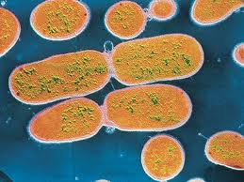
Monera Kingdom
Bacteria: Prokaryotic organisms

Slide 2
Bacteria

Slide 3
Characteristics:
Prokaryotic and unicellular organisms. Bacteria sometimes grow in colonies.
They are the most abundant organisms on Earth and can survive in any type of envronments.
Structure: Cell membrane – cell wall – cytoplasm – DNA – flagella or cillia.
Shapes:
Spherical: coccus (cocci)
Rod-shaped: bacillus (bacilli)
Curved : vibrio
Spiral: spirillum

Slide 4
Vital functions
Nutrition:
Bacteria can be autotrophs or heterotrophs.
Reproduction:
Binary fission
Interaction:
Bacteria are able to detect changes and respond to them.

Slide 5
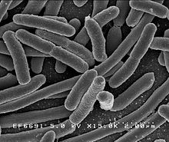
Environment
Autotrophic bacteria live in aquatic ecosystems
Heterotrophic bacteria are :
Saprophytes: Decomposers
Live in other organisms (producing effects or not) like gut flora (symbionts) or Salmonella (parasites)
Escherichia coli

Slide 6
Protista Kingdom
Eukaryotic cells.
Types:
PROTOZOA:
Amoebae
Vorticellae
Trypanosomes
ALGAE:
Green algae
Brown algae
Red algae

Slide 7
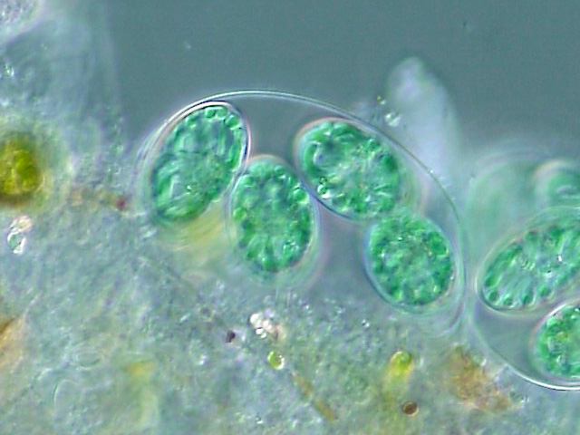
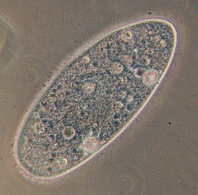
Protozoa Algae

Slide 8
Characteristics
Protozoa
Algae
Unicellular
Heterotrophs
Aquatic environments
Different types of movement facilities:
Pseudopods
Flagella
Cillia
Types of life: free (amoeba), parasites (Trypanosomes), attached (Vorticella)
Unicellular or multicellular (colonies)
Autotrophs
Aquatic
Colors:
Green algae: multi and unicellular. (Plancton)
Brown: some grow 50 m long
Red: attached to the floor or animal shells

Slide 9
Vital Functions
Porozoa
Algae
Nutrition: Heterotrophic
Reproduction: asexual
Interaction:
It detects changes in the environment and reacts to them.
Movement
Others live attached and move the water around them.
Nutrition: Autotrophic
Reproduction: asexual
Interaction: reactions
Some of them live free in water, some others are attached to the ocean floor or to shells.

Slide 10
Radyolars (unicellular algae)

Slide 11
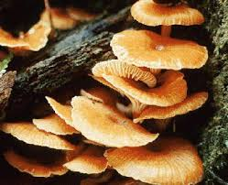
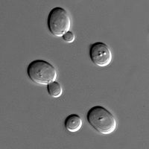
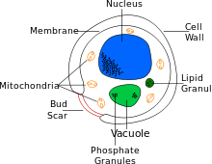
Fungi
Eukaryotic
Heterotrophic
Unicellular (Yeast) or multicellular (Mushrooms)
No tissues
Cells have cellular wall (different to plant cells)

Slide 12
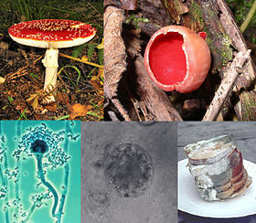
Multicellular fungi
Some fungi are made up or fine threads called hyphae. Hyphae are packed tightly together forming a mycellium.

Slide 13
Nutrition
Saprotrophs: they feed on the remains of dead organisms.
Parasites: they feed on living organisms causing illnesses.
Symbionts: feed by associating with autotrophic organisms live algae in lychens.

Slide 14
Reproduction and interaction
Asexual reproduction. Fungi produce spores .
They usually live in the soil in damp and dark places. Even when they live in other organisms.

Slide 15
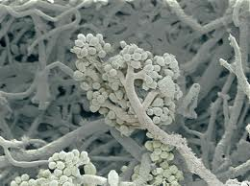
Types
http://upload.wikimedia.org/wikipedia/commons/2/27/DecayingPeachSmall.gif

