Slide 1
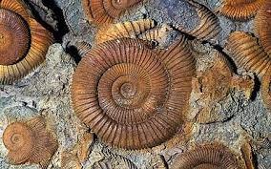
FOSSILS

Slide 2
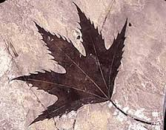
WHAT IS A FOSSIL ?
(Brainstorm)

Slide 3
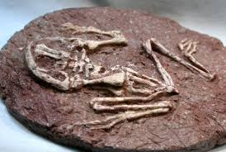
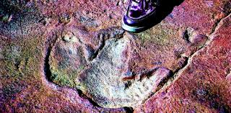
The characteristics that a fossil needs to have:
*be a part of a living being o some trace of its activity
* to be more than 10,000 years old

Slide 4
ARE THEY FOSSILS?
In groups of four people, students will decide if these following things are or not fossils.
After that, they will determine if the fossils are body fossil or trace fossil and will explain why they have made that choice.

Slide 5
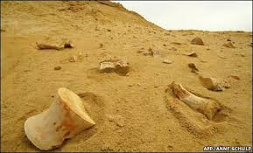
BONE (200,000 years old)

Slide 6
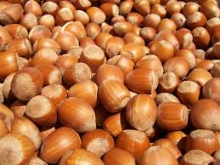
HUZELNUTS

Slide 7
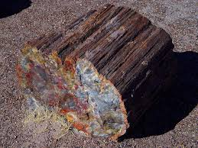
WOOD (100 years old)

Slide 8
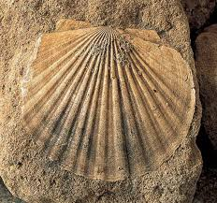
SHELL (100,000 years old)

Slide 9
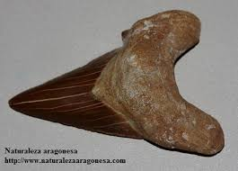
SHARK TOOTH (40,000 years old)

Slide 10
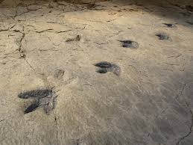
DINOSAUR FOOTPRINT

Slide 11
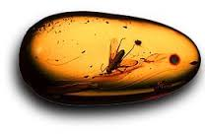
INSECTS IN AMBER

Slide 12
LET’S SEE!

Slide 13
BONE, is a body fossil

Slide 14
HUZELNUT, is not a fossil, not old enough

Slide 15
WOOD, could be a fossil, a body fossil, but in this case is not enough

Slide 16
SHELL, is a fossil, a body fossil

Slide 17
SHARK TOOTH, a body fossil

Slide 18
DINOSAUR FOOTPRINT, is a trace fossil

Slide 19
INSECTS IN AMBER, are body fossils

Slide 20
CARDS.
In groups of four people, students will designe a card, in which they will write two characteristics that something needs to have to be a fossil
Students will also draw some fossil that they have seen in the current activity.

Slide 21
GROUP ONE, CARD
A part of a living being or some trace of its activity. To be more than 10,000 years old.

Slide 22
QUESTIONS ABOUT FOSSILS:
1. An example of a trace fossil is ______.
A preserved path of footprints
A preserved jawbone
A preserved seashell
A preserved shark tooth
2. An example of a body fossil is_____.
A preserved foot print
A preserved egg
A preserved dinosaur skull
A preserve reptile nest

Slide 23
STEPS OF THE FOSSILIZATION PROCESS.
Students will have to order the following steps, thinking about how the fossilization process acts :
A fish is buried by mud and sediments
After millions of years, more mud and sediments pilled up in layers adding more weight and preassure turning the layers into rock
Minerals help to preserve the bones, and harder them
A fish dies and sinks to the ocean floor
The soft parts of the body, rot away

Slide 24
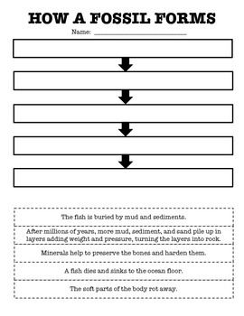

Slide 26
WHAT ARE FOSSILS USED FOR??

Slide 27
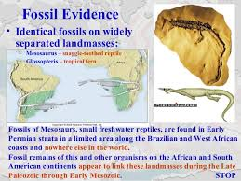

Slide 28
EVOLUTION

Slide 29
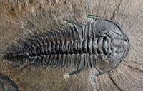
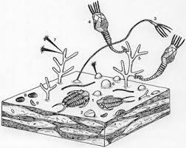
PALEOECOLOGY
uses data from fossils and subfossils to reconstruct the ecosystems of the past.

Slide 30
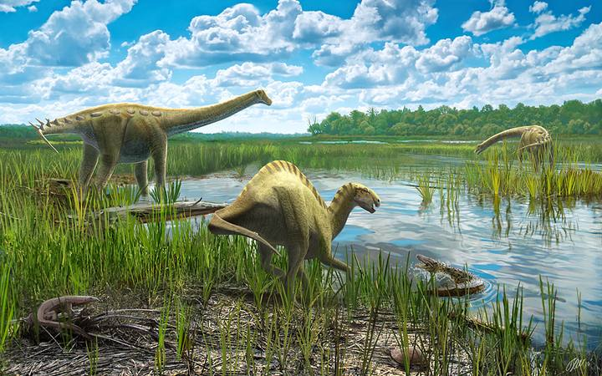

Slide 31
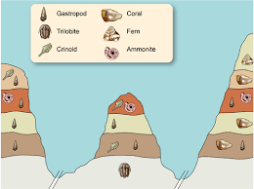
INDEX FOSSILS
Index fossils (also known as guide fossils, indicator fossils or zone fossils) are fossils used to define and identify GEOLOGIC PERIODS.

Slide 32
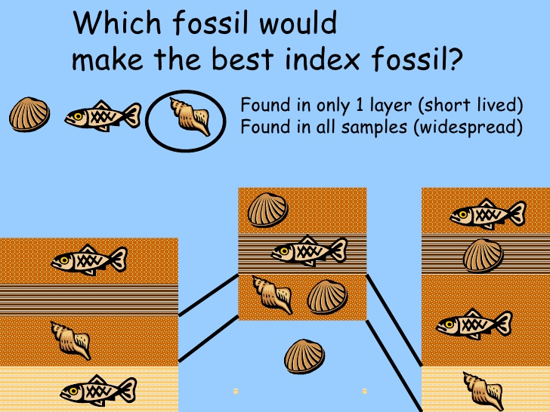

Slide 33
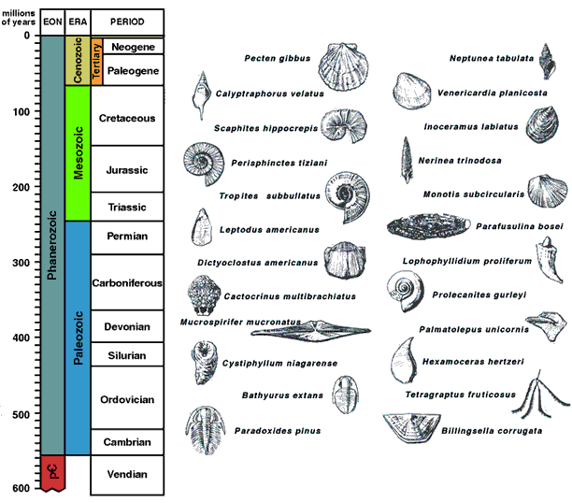

Slide 34
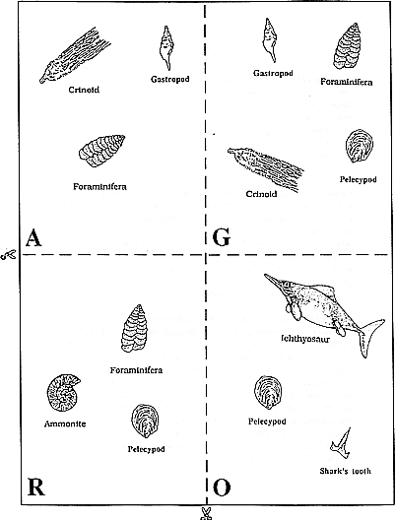
WHO WAS FIRST?

