Slide 1
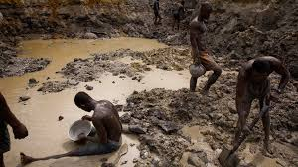
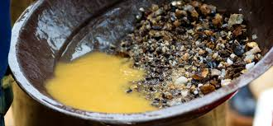
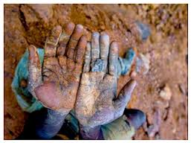
Conflict Minerals

Slide 2
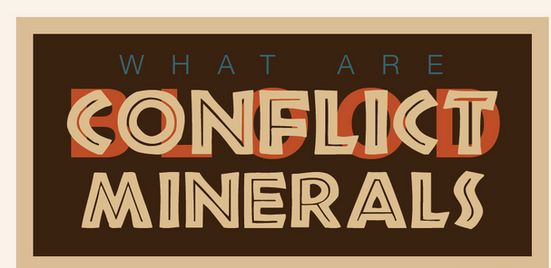
What are Conflict Minerals?

Slide 3
Conflict Minerals
Conflict minerals are minerals mined in conditions of armed conflict and human rights abuses, and which are sold or traded by armed groups.

Slide 4
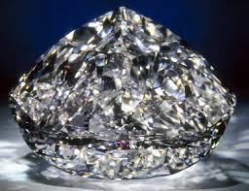
Tantalum, Tin, Tungsten, Gold and Diamonds

Slide 5
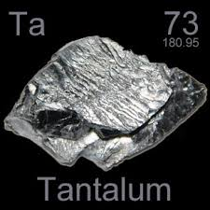
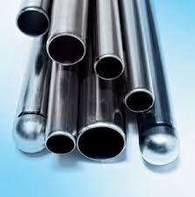
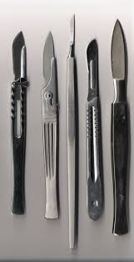
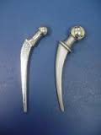
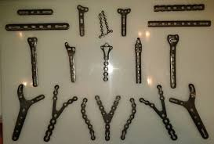
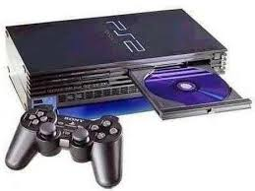
Tantalum
Tantalum is highly corrosion-resistant.
Tantalum is used to make minor components in alloys and airplane components
The chemical inertness of tantalum makes it a valuable substance for laboratory equipment and a substitute for platinum.
Tantalum is also used for medical implants and bone repair.
Its main use today is in tantalum capacitors in electronic equipment such as mobile phones, DVD players, video game systems and computers.

Slide 6
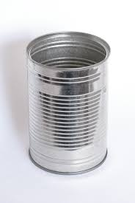
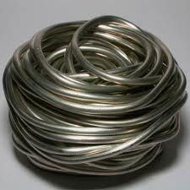
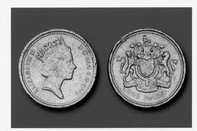
Tin
Plating and solders for joining pipes and electronic circuits
Alloys
Food cans

Slide 7
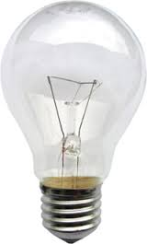
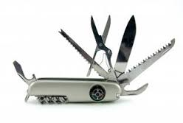
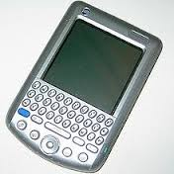
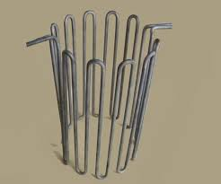
Tungsten
Metal wires
Electrodes and contacts in lighting, electronic, electrical, heating and welding applications

Slide 8
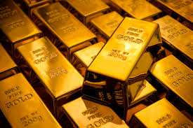
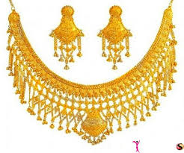
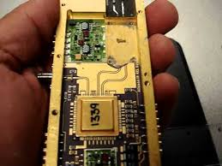
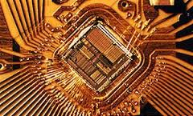
Gold
Jewellery
Electronic
Communications
Aerospace equipment

Slide 9
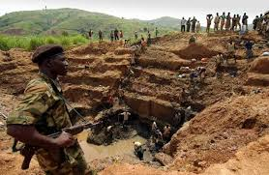
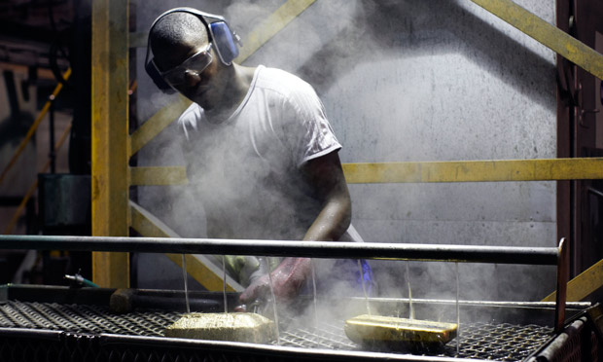
Gold and Conflict

Slide 10
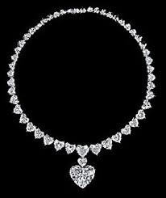
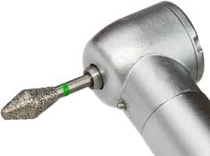
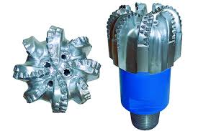
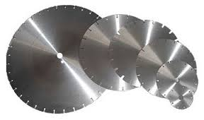
Diamonds
Jewelry
Grinding wheels, saw blades, or drill bits.
Ground into a powder and made into a diamond paste that is used for polishing or for very fine grinding.
Diamond windows and used to cover openings in lasers, x-ray machines and vacuum chambers. They are transparent, very durable and resistant to heat and abrasion.
Diamond speaker domes enhance the performance of high quality speakers.
Heat sinks- It is used to conduct heat away from the heat sensitive-parts of high performance microelectronics.
Low friction microbearings- are needed in tiny mechanical devices. Just as some watches have jewel bearings in their movements diamonds

Slide 11
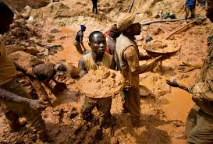
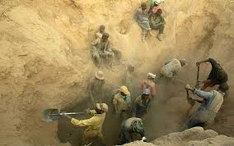
Conflict Diamonds - ¨Blood¨ Diamonds
diamonds mined in a war zone
sold to finance an insurgency, an invading army's war efforts, or a warlord's activity

Slide 12
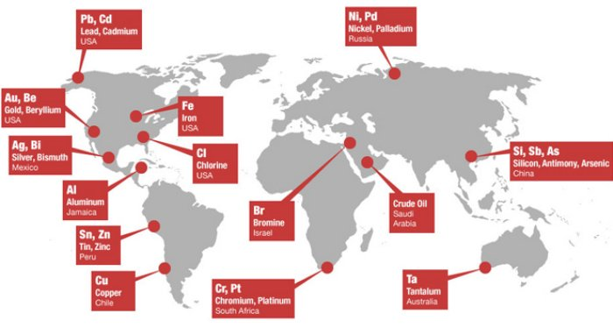
Where are these minerals found?

Slide 14
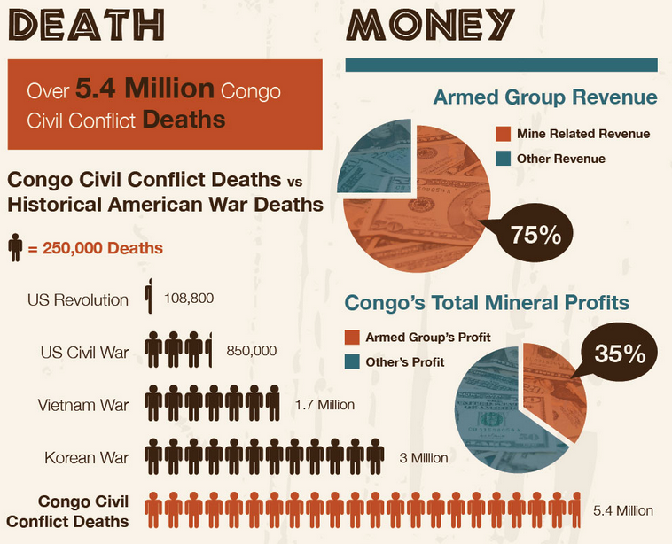

Slide 15
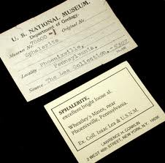
How can we stop the conflict?
Regulations
Law
Labelling
Companies must operate responsibly

Slide 16
Where are conflict minerals found?
Companies source minerals from conflict-affected and high-risk areas around the world. Minerals, precious stones and other natural resources have funded violence in Colombia, Afghanistan, Zimbabwe, Burma and the Central African Republic

Slide 17
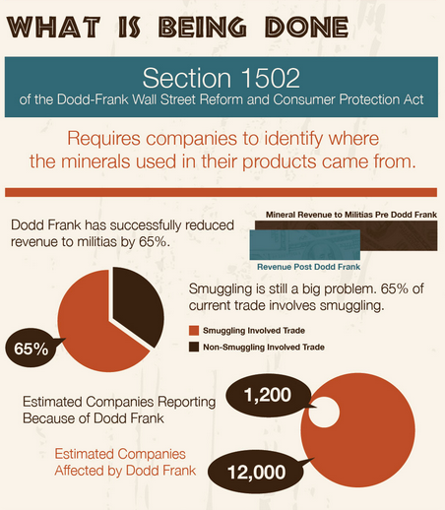

Slide 18
Act Responsibly & Know What You are Buying

